Slide 1
Smart Greenify Device
Group 1

Slide 2
Interfacing Humidity and Temperature Sensor
Submitted by,
Anna Joy
Group 1, Individual Meeting 1.

Slide 3
Introduction
Smart Greenify is a device that helps indoor plants to survive without much effort from the owner.
The device has sensors to detect the water level, humidity, and temperature, and all these parameters can be controlled by the particular plant’s requirement.
The MCU used here is Raspberry pi and this presentation mainly focuses on the interfacing between the temperature and humidity sensor and Raspberry pi.

Slide 4
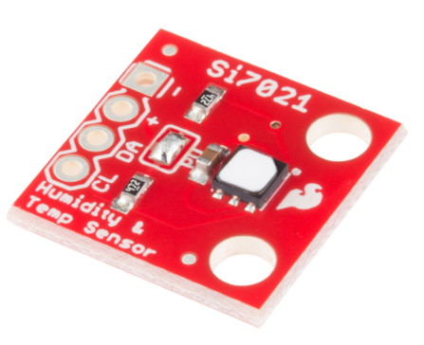
Sensor used in this project

Slide 5


Communication Protocol Used
Temp/Humidity and Moisture sensors are connected through I2C communication
Pin 3 and 5 on raspberry pi are SDA and SCL with I2C, data is transferred in messages.
Messages are broken up into frames of data.

Slide 6
I2C Communication Protocol
I2C stands for Inter-Integrated Circuit.
I2C is a serial communication protocol, so data is transferred bit by bit along a single wire (the SDA line).
By using I2C, we are able to connect multiple slaves to a single master (like SPI) and can have multiple masters controlling single, or multiple slaves.
I2C is synchronous, so the output of bits is synchronized to the sampling of bits by a clock signal shared between the master and the slave.
The clock signal is always controlled by the master.

Slide 7
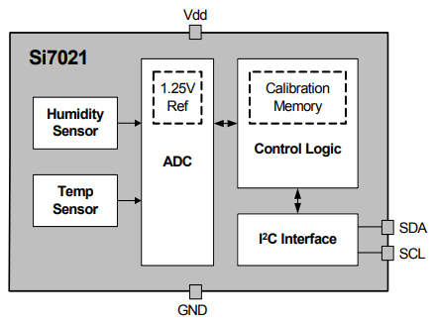
Functional Block Diagram of Si7021

Slide 8
Steps for Interfacing Temperature and Humidity Sensor:-
Step 1:Set up Raspberry pi 4
Step 2: Enable I2C on Raspberry pi
While using VNC (or directly connect to Raspberry pi via HDMI cable to a monitor)
Go to Application menu (Raspberry icon on the left top corner)
Select Preference => Raspberry pi configuration => interface => enable I2C

Slide 9
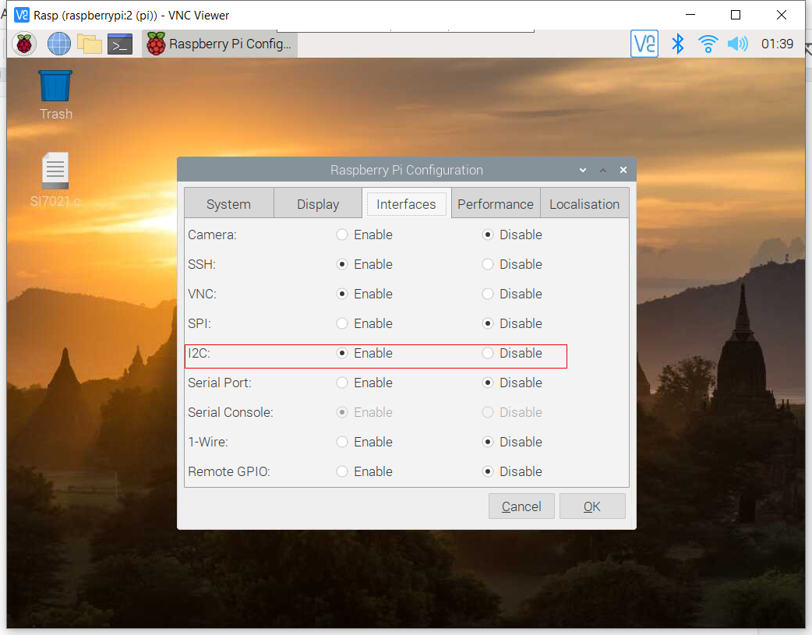

Slide 10
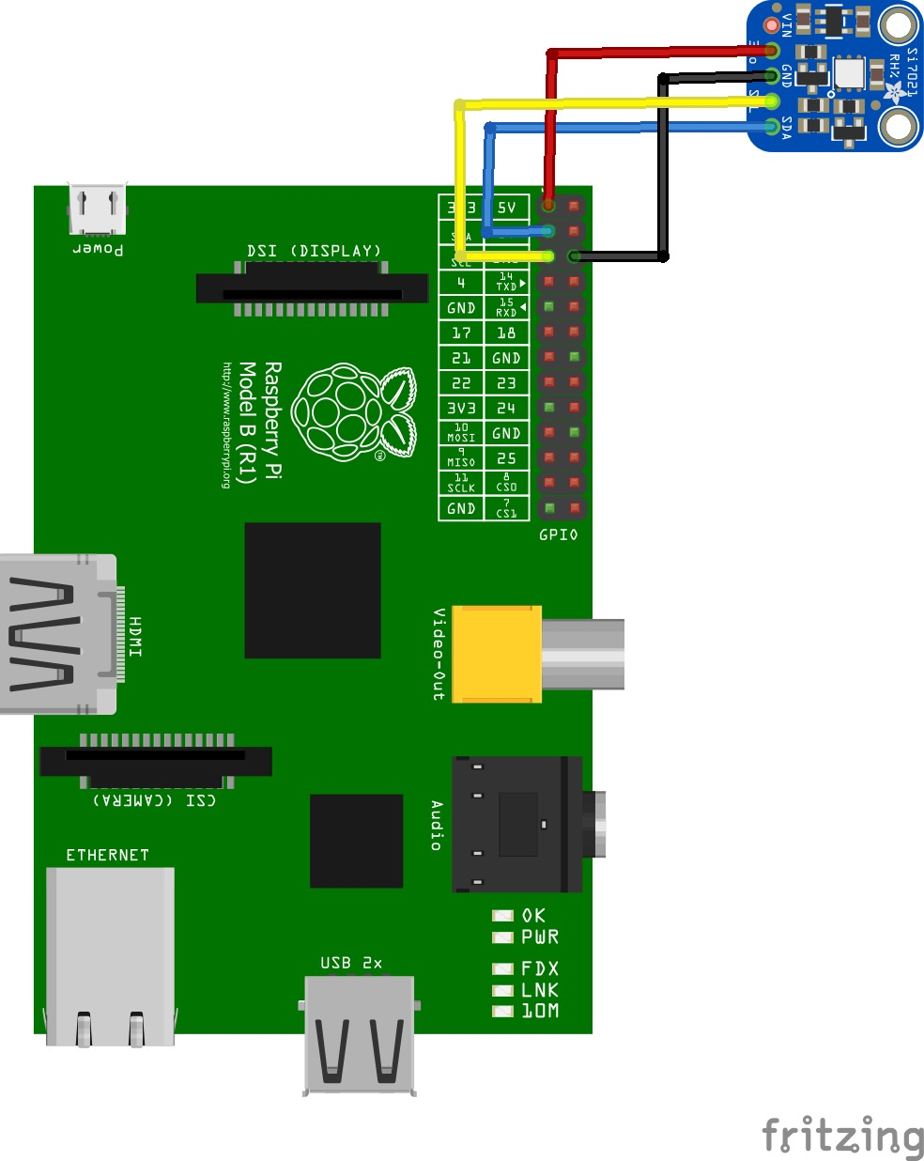
Step 3: Connect the sensor to Raspberry pi 4 as per the connection diagram

Slide 11
Connections from Raspberry -> sensor
3.3 V → (+) pin
GND → (-) pin
GPIO 2 SERIAL DATA (I2C) → DA
GPIO 3 SERIAL CLOCK (I2C) → CLK

Slide 12
pi@raspberrypi:~/Desktop $ sudo i2cdetect -y -a 1 0 1 2 3 4 5 6 7 8 9 a b c d e f 00: 00 -- -- -- -- -- -- -- -- -- -- -- -- -- -- -- 10: -- -- -- -- -- -- -- -- -- -- -- -- -- -- -- -- 20: -- -- -- -- -- -- -- -- -- -- -- -- -- -- -- -- 30: -- -- -- -- -- -- -- -- -- -- -- -- -- -- -- -- 40: 40 -- -- -- -- -- -- -- -- -- -- -- -- -- -- -- 50: -- -- -- -- -- -- -- -- -- -- -- -- -- -- -- -- 60: -- -- -- -- -- -- -- -- -- -- -- -- -- -- -- -- 70: -- -- -- -- -- -- -- -- -- -- -- -- -- -- -- --
Step 4: Checking the new I2C device on raspberry pi
0x40 is the sensor i2c bus address

Slide 13
Step 4b Reading value from the register of the attached device by using i2cdump
pi@raspberrypi:~ $ i2cdump -y 1 0x40 b 0 1 2 3 4 5 6 7 8 9 a b c d e f 0123456789abcdef 00: 00 00 00 00 00 00 00 00 00 00 00 00 00 00 00 00 ................ 10: 00 00 20 00 00 00 00 00 00 00 00 00 00 00 00 00 .. ............. 20: 00 00 00 00 00 00 00 00 00 00 00 00 00 00 00 00 ................ 30: 00 00 00 00 00 00 00 00 00 00 00 00 00 00 00 00 ................ 40: 00 00 00 00 00 00 00 00 00 00 00 00 00 00 00 00 ................ 50: 00 00 00 00 00 00 00 00 00 00 00 00 00 00 00 00 ................ 60: 00 00 00 00 00 00 00 00 00 00 00 00 00 00 00 00 ................ 70: 00 00 00 00 00 00 00 00 00 00 00 00 00 00 00 00 ................ 80: 00 00 00 00 00 00 00 00 00 00 00 00 00 00 00 00 ................ 90: 00 00 00 00 00 00 00 00 00 00 00 00 00 00 00 00 ................ a0: 00 00 00 00 00 00 00 00 00 00 00 00 00 00 00 00 ................ b0: 00 00 00 00 00 00 00 00 00 00 00 00 00 00 00 00 ................ c0: 00 00 00 00 00 00 00 00 00 00 00 00 00 00 00 00 ................ d0: 00 00 00 00 00 00 00 00 00 00 00 00 00 00 00 00 ................ e0: 6a 65 00 6a 00 65 00 3a 00 00 00 00 00 00 7f 00 je.j.e.:......?. f0: 00 00 00 XX XX XX XX XX XX XX XX XX XX XX XX XX ...XXXXXXXXXXXXX

Slide 14
I2C Interface
The Si7021 communicates with the host controller over a digital I2C interface.
The 7-bit base slave address is 0x40.
Master I2C devices communicate with the Si7021 using a command structure.
The commands are listed in the I2C command table.

Slide 15
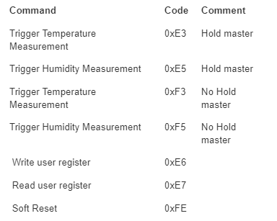

Slide 16
PS D:\Google Drive\Study\Lambton\Sem 4\-Greenify-Device-Project\Interfacing\si7021 sensor> scp SI7021.c pi@192.168.2.33:~/Desktop pi@192.168.2.33's password: SI7021.c 100% 1770 28.5KB/s 00:00
Step 5: Using the code si7021.c from ControlEverythingCommunity https://github.com/ControlEverythingCommunity/SI7021/blob/master/C/SI7021.c
From host machine, open the terminal then transfer the file to raspberry pi (or you can create a code file by “touch” command)
Story for illustration purposes only

Slide 17
Open the file we just copied to raspberry pi and adding the unistd.h library
pi@raspberrypi:~/Desktop $ sudo nano SI7021.c

Slide 18
Adding this line to the code:
#include <unistd.h>

Slide 19
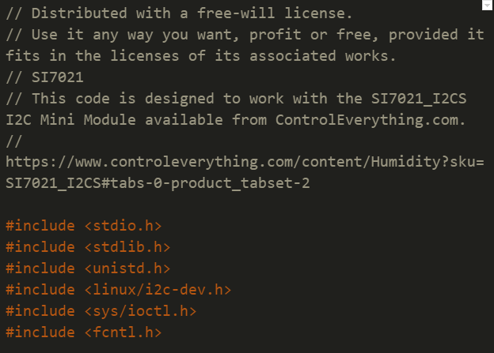
SI7021.c file:

Slide 20
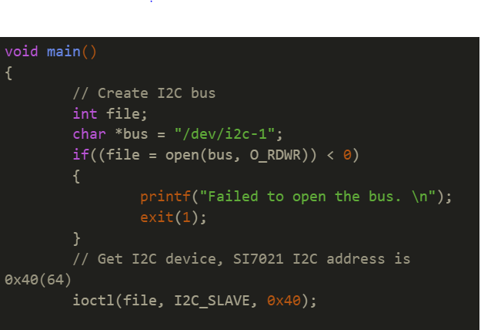

Slide 21
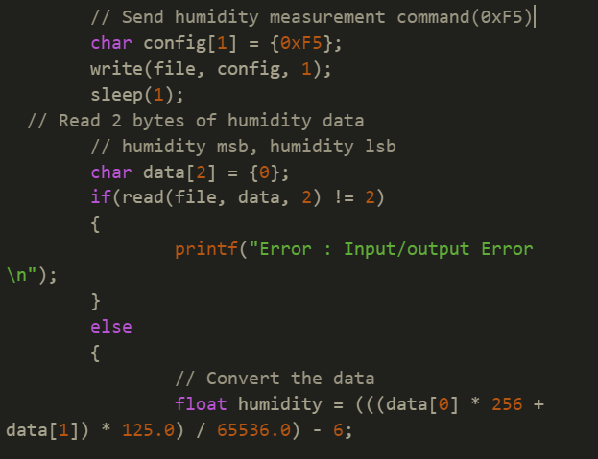

Slide 22
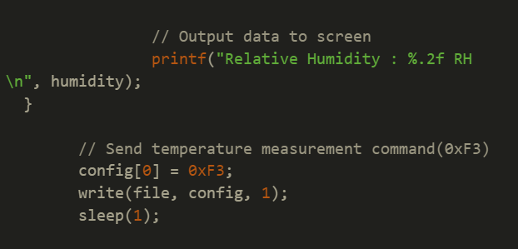

Slide 23
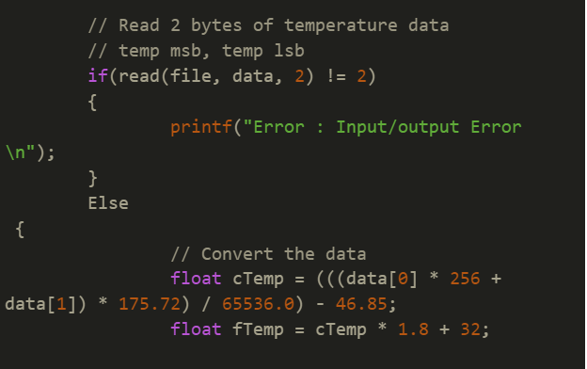

Slide 24
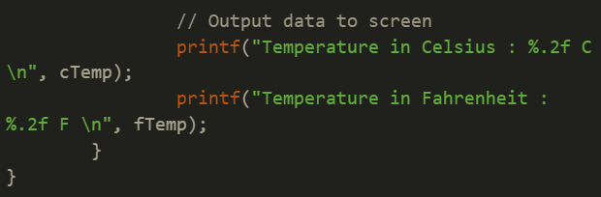

Slide 25
fcntl.h
fcntl.h is a header file
Defines values for the fcntl and open subroutines.
Purpose of this header file is to define file control options.
The /usr/include/fcntl.h file defines the values that can be specified for the Command and Argument parameters of the fcntl subroutine and for the Oflag parameter of the open subroutine.

Slide 26

Measuring Relative Humidity
Once a relative humidity measurement has been made, the results of the measurement may be converted to percent relative humidity by using the following expression:
Where: %RH is the measured relative humidity value in %RH,
RH_Code is the 16-bit word returned by the Si7021

Slide 27

Measuring Temperature
The results of the temperature measurement may be converted to temperature in degrees Celsius (°C) using the following expression:
Where: Temperature (°C) is the measured temperature value in °C Temp_Code is the 16-bit word returned by the Si7021

Slide 28
Step 6: Run the executable file.
pi@raspberrypi:~/Desktop $ pi@raspberrypi:~/Desktop $ ./SI7021 Relative Humidity : 43.38 RH Temperature in Celsius : 26.33 C Temperature in Fahrenheit : 79.39 F

Slide 29
Thank you

Slide 30
References
Linux.die.net. 2021. sleep(3): sleep for specified number of seconds - Linux man page. [online] Available at: <https://linux.die.net/man/3/sleep <> [Accessed 23 June 2021].

Slide 31
References
2.User, S., 2021. Raspberry Pi And The IoT In C - I2C Bus. [online] Iot-programmer.com. Available at: <https://www.iot-programmer.com/index.php/books/22-raspberry-pi-and-the-iot-in-c/chapters-raspberry-pi-and-the-iot-in-c/61-raspberry-pi-and-the-iot-in-c-i2c-bus?start=3> [Accessed 23 June 2021].

Slide 32
3.GitHub. 2021. ControlEverythingCommunity/SI7021. [online] Available at: <https://github.com/ControlEverythingCommunity/SI7021/blob/master/C/SI7021.c> [Accessed 23 June 2021].
4.Silabs.com. 2021. [online] Available at: https://www.silabs.com/documents/public/data-sheets/Si7021-A20.pdf [Accessed 24 June 2021].

Slide 33
5.Campbell, S., 2021. Basics of the I2C Communication Protocol. [online] Circuit Basics. Available at: <https://www.circuitbasics.com/basics-of-the-i2c-communication-protocol/> [Accessed 24 June 2021].

